Slide 1

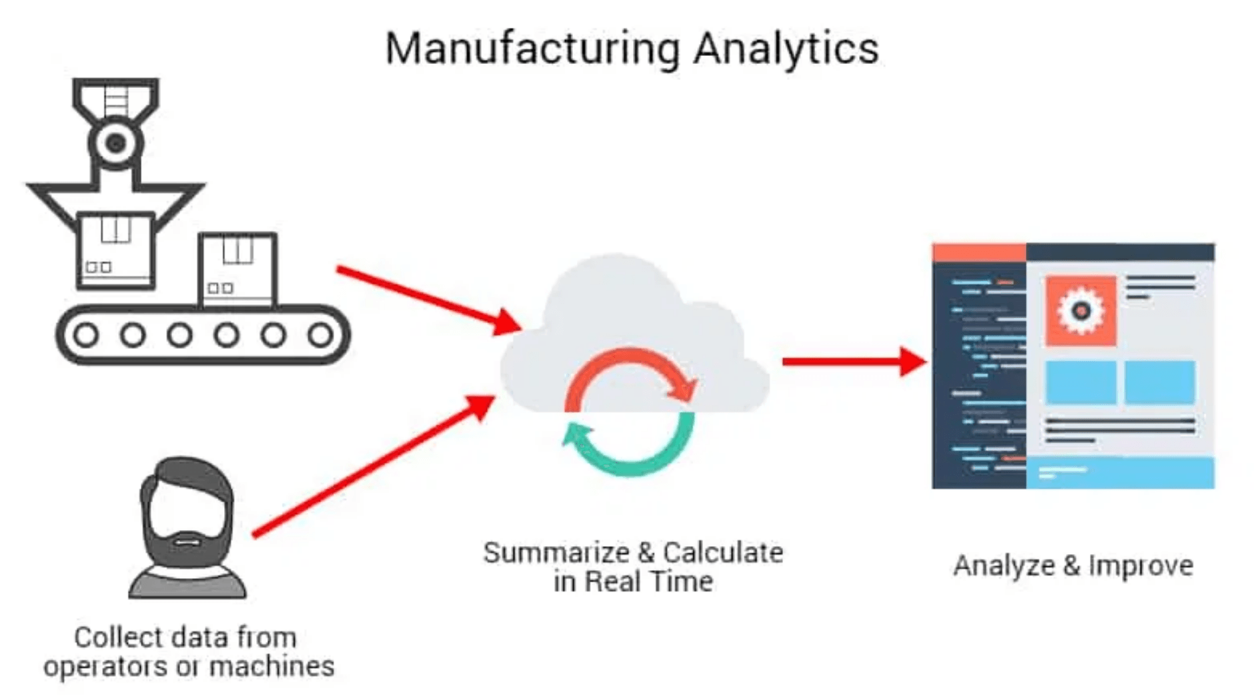
Manufacturing Downtime Analysis and Optimization Project
Analytical Insights to Enhance Plant Reliability and Operational Efficiency
Team: Team 184 (DKH3_DATA2_G1)
Date: November 2025

Slide 2
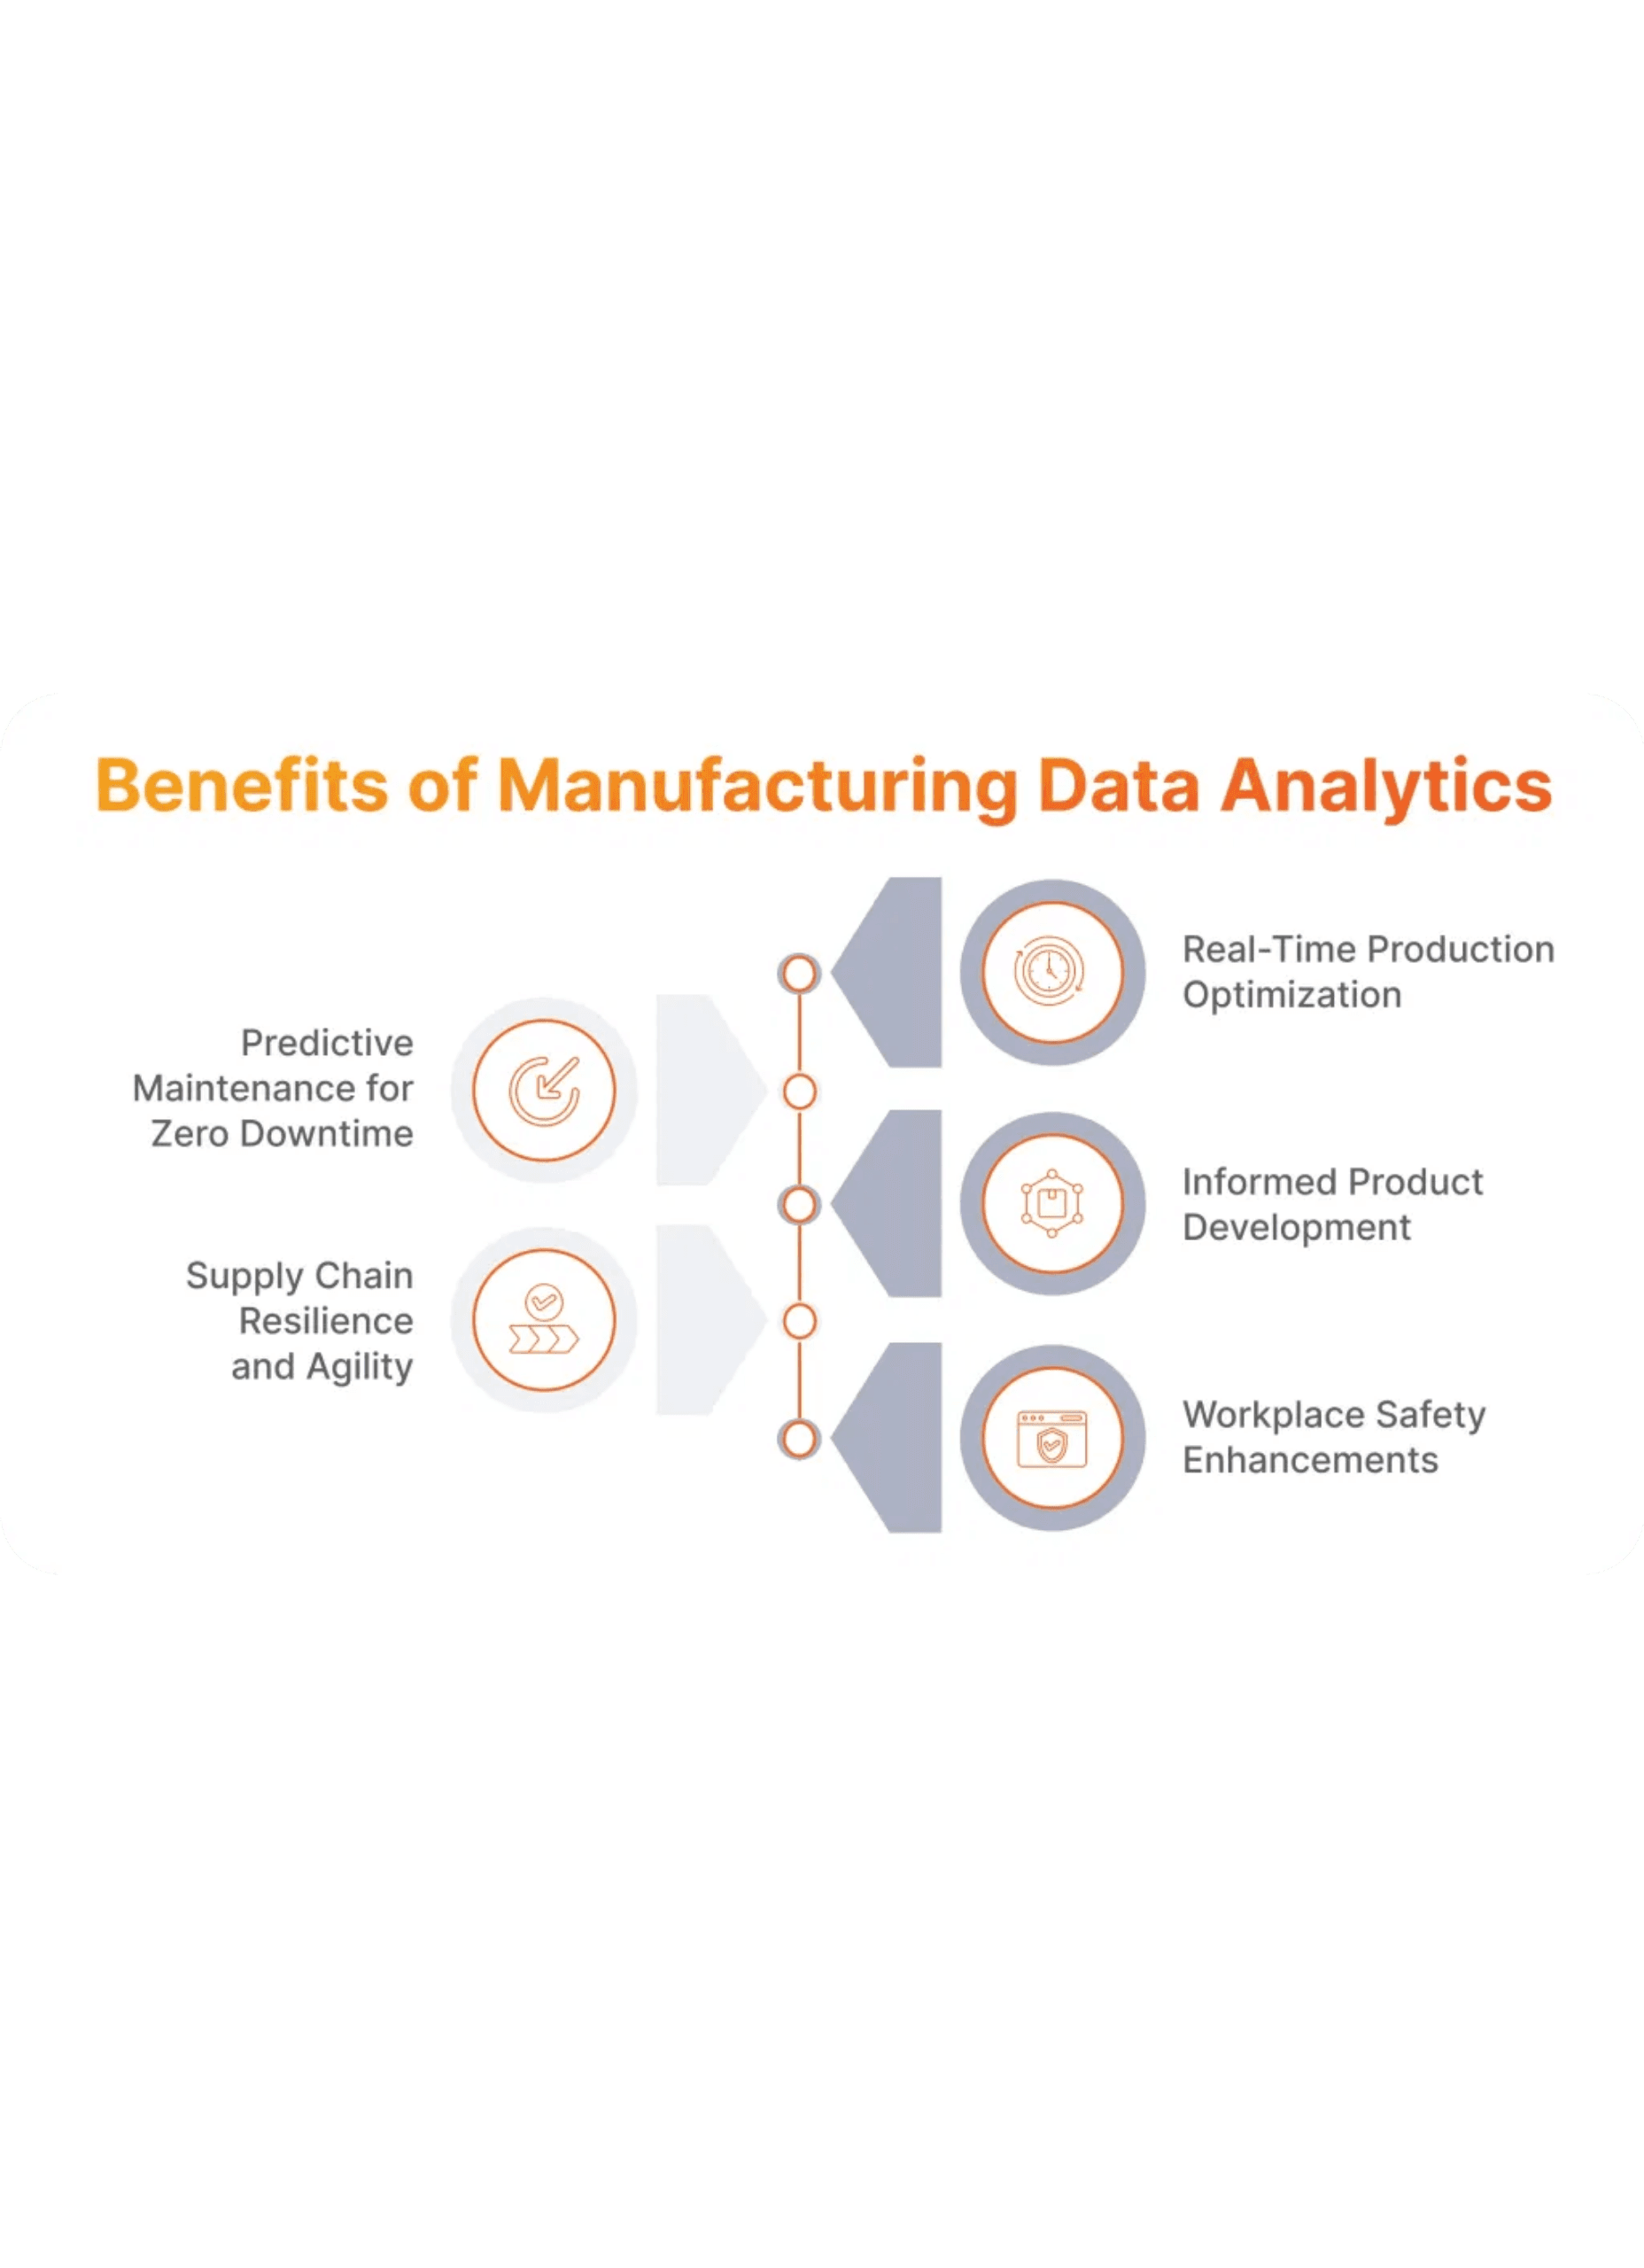



Project Idea and Goal
The project aims to design and develop a comprehensive Power BI analytics solution for monitoring and optimizing manufacturing downtime in a production facility, integrating maintenance, production, equipment, and cost data.
Enhance Plant Reliability
Increase operational efficiency and reduce unplanned downtime.
Provide Data-Driven Insights
Transform raw data into effective strategic decisions for management support.
Cost Control
Identify direct and indirect financial losses from downtime and provide
recommendations for reduction.

Slide 3

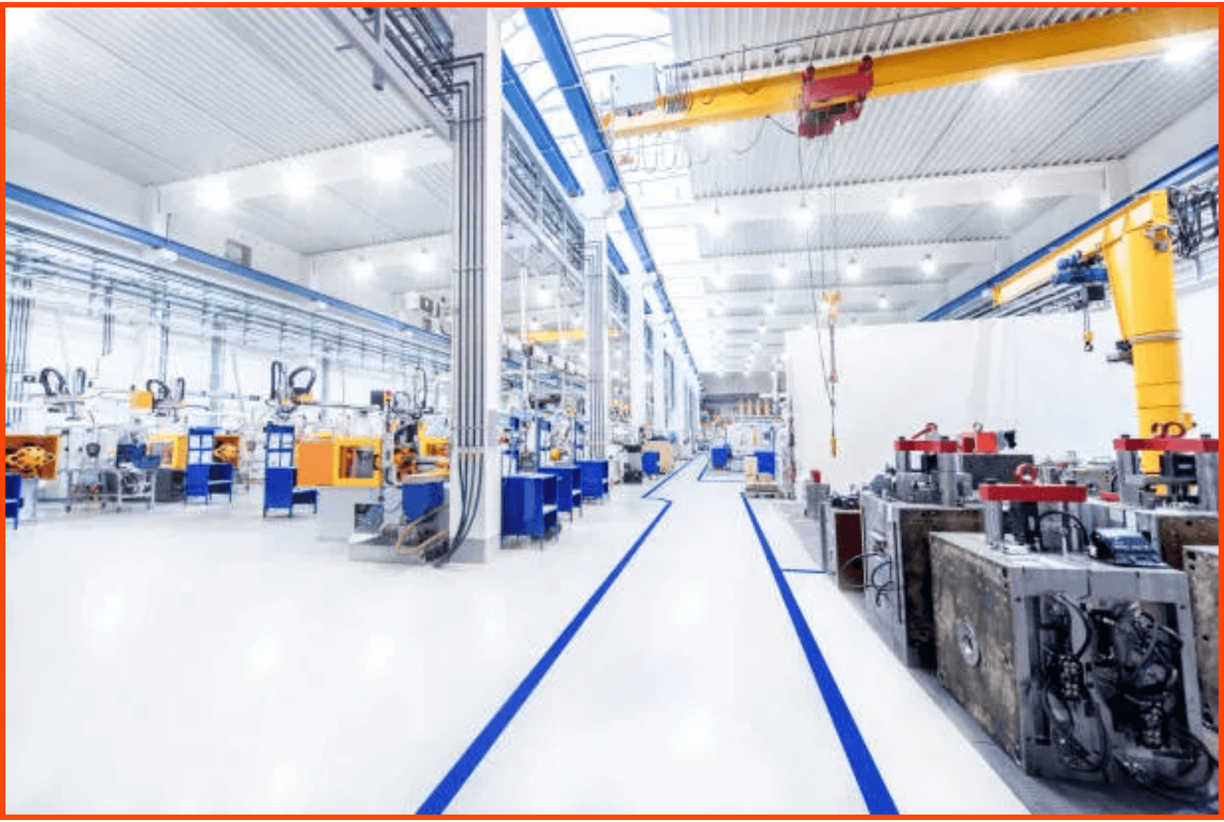

Challenge and Initial Findings: Problem Scale
The manufacturing facility faced significant challenges with production losses and high maintenance costs resulting from unplanned downtime. This project aims to quantify these losses and provide an immediate analytical solution.
35.77K
145.27K
Recorded Downtime Hours
Production Loss (units/ton)
Recurring Root Causes:
Wear and Corrosion, indicating an urgent need for more
effective preventive maintenance programs.

Slide 4
Team and Roles: Integrated Expertise for Success
Mostafa Mohsen Fathy
Mohamed Elsaid Elsaid Mahmoud
Data Pre-processing
Data Modeling
Cleaning, exploration, and pre-processing of raw data to ensure quality for analysis and reporting.
Creating data models and relationships between tables in Power BI to provide a strong and reliable foundation for analysis.
Yousif Naser Elsayed
Osama Elsayed Shawki
Dashboard Development
Analysis and Presentation
Designing and developing interactive Power BI dashboards to present insights clearly and effectively to users.
Analyzing achieved results, preparing the final presentation, and strategic recommendations to support management decisions.

Slide 5




Project Explanation: Operational Analysis Features
Comprehensive Downtime Analysis
Tracking total downtime hours and classifying failures to identify the most impactful causes on production through detailed failure classification.
✓ Trend Analysis | Root Cause Identification
Maintenance Team Efficiency (MTTR)
Mean Time To Repair (MTTR) is 6.02 hours. Analyzing MTTR for critical failures (7.97 hours) to identify opportunities for improving response speed.
✓ MTTR for Critical Failures: 7.97 hours | Response Speed Improvement
Linking Downtime to Production Losses
Quantifying direct production losses from unplanned downtime (145.27K units/ton), helping prioritize repairs based on financial impact.
✓ Downtime-to-Loss Linkage | Repair Prioritization

Slide 6




Advanced Financial and Managerial Insights
The project provides comprehensive financial analysis to help management make informed strategic decisions about resource allocation and investments.
Maintenance Cost Analysis
Detailing costs by component (Spare Parts 95.2%, Labor 3.5%, Other 1.2%) and maintenance category (Electrical, Mechanical, Instrumentation).
Total Costs: $30.67M
Downtime Cost Analysis
Identifying equipment with the highest downtime cost (e.g., Urea Granule Conveyor) to focus maintenance efforts on critical assets.
Average Downtime Cost: $1,592
Inventory Management
Monitoring total inventory value and identifying spare parts that have reached reorder level (32 items) to ensure availability.
Total Inventory Value: $70.65M

Slide 7

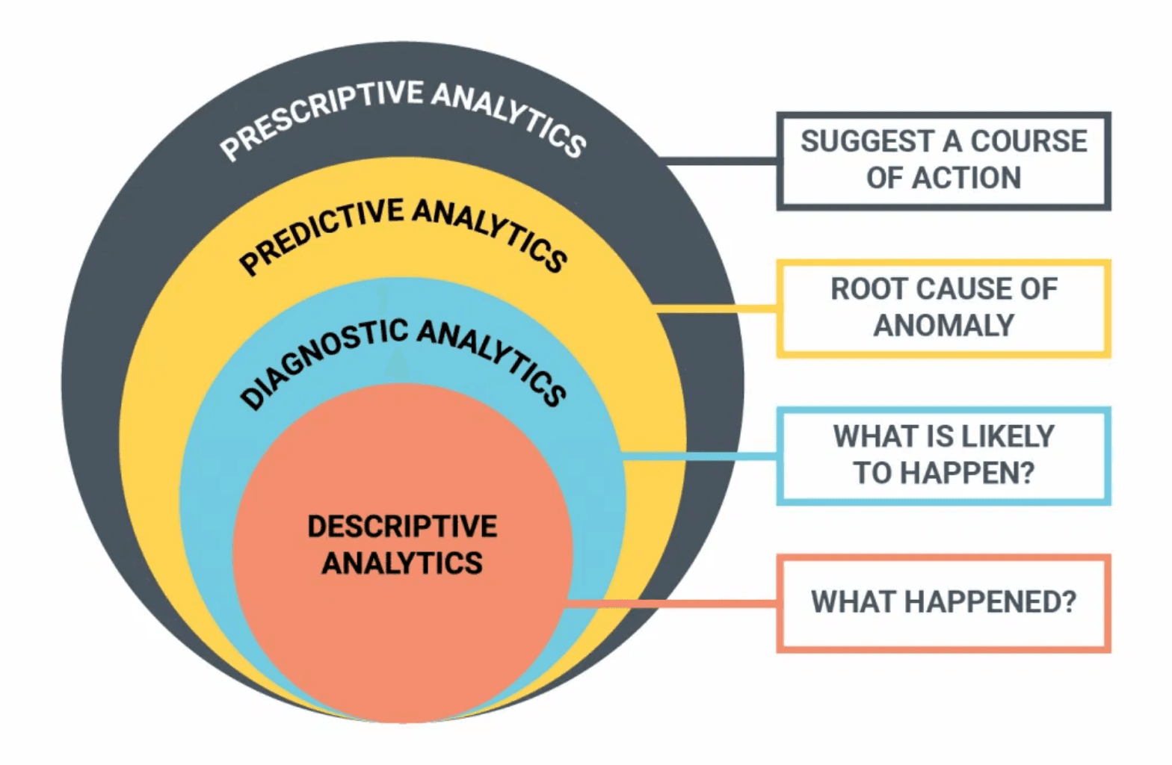


Future Ideas: Strategic Roadmap
Technical Development
▸
Predictive Maintenance: Integrating Machine Learning models to predict failures based on wear and corrosion patterns.
▸
Smart Automation: Developing an automated alert system and smart maintenance recommendations.
▸
Real-time Monitoring: Connecting the dashboard to SCADA/IoT systems for instant data feeds.
Marketing and Expansion
▸
Scaling: Applying the solution to other departments and plants within the company.
▸
Full Integration: Complete integration with ERP and accounting systems to resolve financial discrepancies.
▸
Training and Support: Comprehensive training programs for maintenance and management teams.
Key Initiatives
▸
Mobile accessibility for real-time performance monitoring.
▸
Resolving financial discrepancies between maintenance and accounting systems.

Slide 8


Conclusion and Call to Action
This project provides a powerful and effective tool for transforming maintenance data into strategic decisions. We have clearly identified key areas for improvement and the root causes of failures, delivering an integrated solution that supports reliability and efficiency improvements.
Adopt the Dashboard: Use the dashboard as the official tool for performance monitoring and continuous KPI tracking.
Approve the Roadmap: Approve the future roadmap to begin implementing predictive models and advanced maintenance strategies.
Improve Data Quality: Enhance data recording procedures and resolve financial discrepancies to ensure analysis accuracy.
Thank you for your time and attention. We are ready to answer any questions and work with you to achieve the targeted results.

